Slide 1

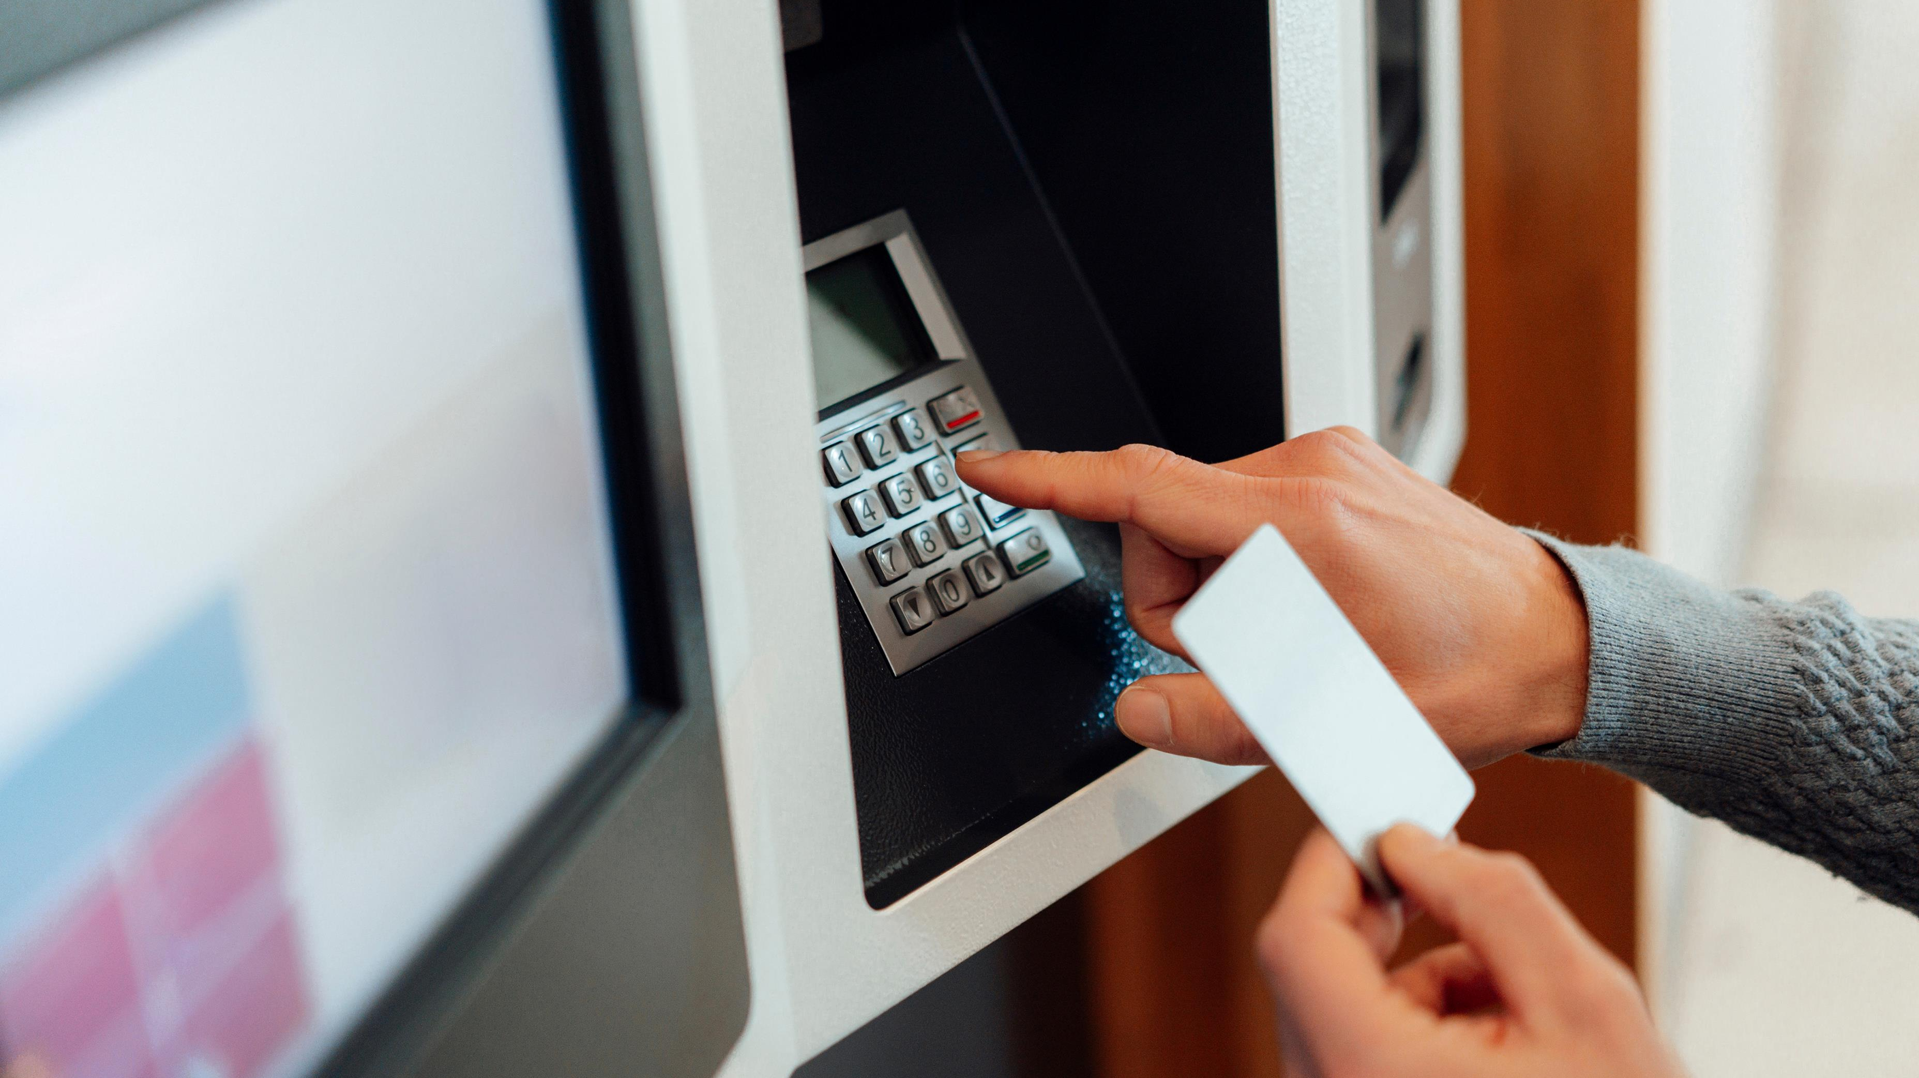
ATM Transaction and Demographic Analysis
Created by: Rupsa Chaudhuri

Slide 2
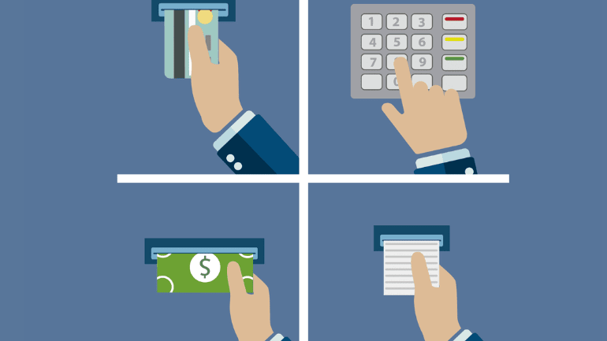
ATM Transaction Report

Slide 3
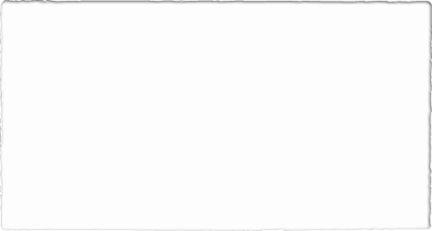

Introduction
Objective: To analyze ATM transaction data from January 1st, 2022 to December 31st, 2022 for insights on customer behavior, ATM usage, and service improvement opportunities.
Scope: Analysis covers all bank branches in Lagos, Kano, Rivers State, Enugu, Rivers, and FCT Abuja.

Slide 4

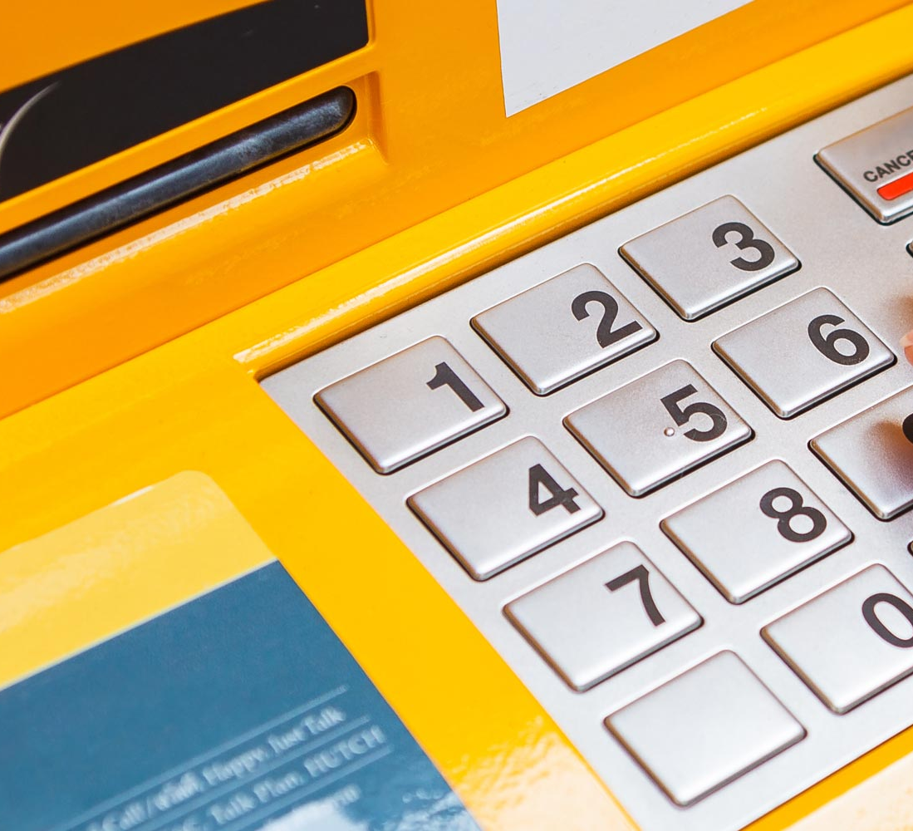
ATM Transaction Analysis
Total amount processed in 2022: $39 billion
Number of transactions processed: 2 million
Total number of customers: 8,819
Utilization rate: 12.9%

Slide 5
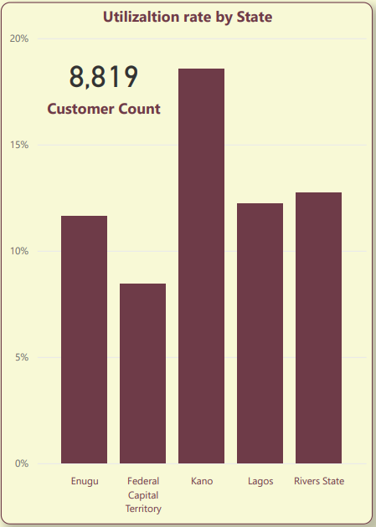
Utilization Rate by State
ATMs in Kano have the highest Utilization Rate (18.6%)
Rivers & Lagos have Utilization Rates greater than 12% (12.7% & 12.2% respectively) while that for Enugu is 11.6%
The FCT has the lowest Utilization Rate (8.5%)

Slide 6
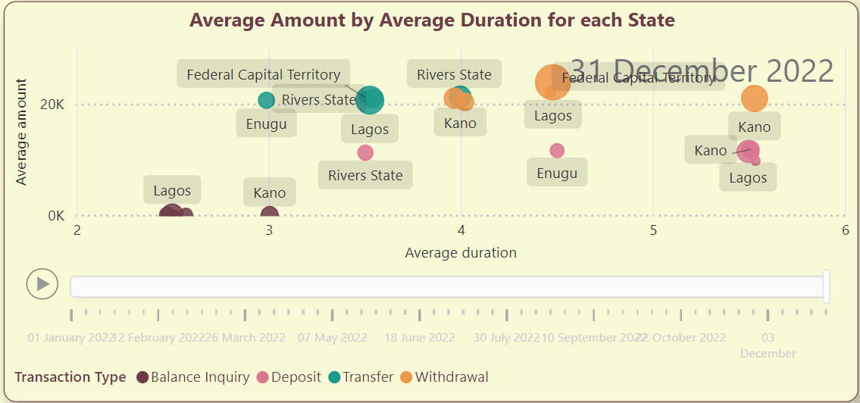
Average Amount vs Average Duration
On Average, while the transaction amount is comparatively similar, Withdrawals in Kano have the longest transaction duration (>5 mins) when compared with other states.
Kano, Lagos, and the FCT have longer transaction duration for Deposits (>5 mins) while Rivers has the lowest transaction duration for deposits.(<4 mins)
Kano also has the longest transaction duration for Balance Inquiries and Transfers.
Withdrawals have the highest transaction amount on average as expected. Withdrawals and Deposits have longer transaction duration on average while Balance Inquiries have the least transaction duration.

Slide 7
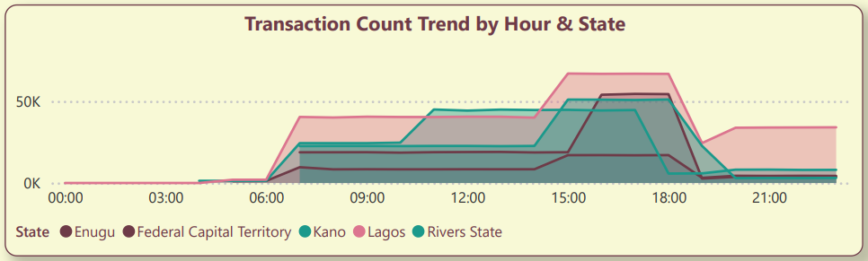
Transaction Count Trend by Hour & State
ATM Transactions in Lagos increase gradually from 6 am and peaks between 3 and 7 pm.
Similar behavior is seen across other states however transactions peak earlier in Kano (around 11 am) and this is sustained till about 5 pm after which activity sharply declines.

Slide 8
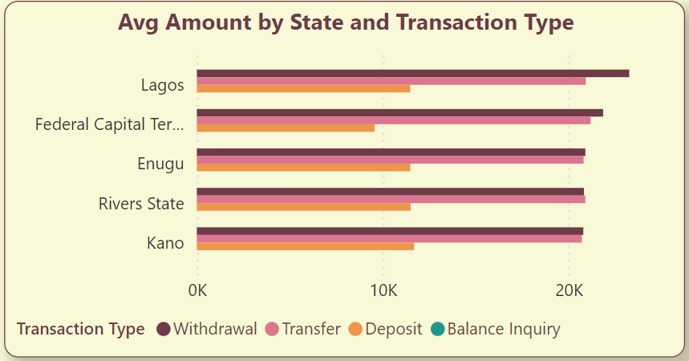
Average transaction Amount
On Average, Withdrawals have the highest transaction amounts across all states, next is Transfers, with Deposits have the lowest.
Across all locations, The FCT has comparatively lower Deposit amounts on Average

Slide 9
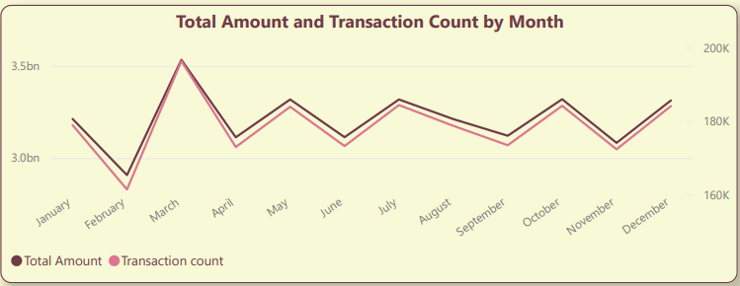
Total Amount and Transaction Count by Month
Transaction volume (both count and amount) exhibits a seasonal trend with March experiencing the peak and February the trough.
Other months with high transaction activity include January, May, July, October, and December

Slide 10

Demographic Report
This Photo by Unknown Author is licensed under CC BY-SA-NC

Slide 11
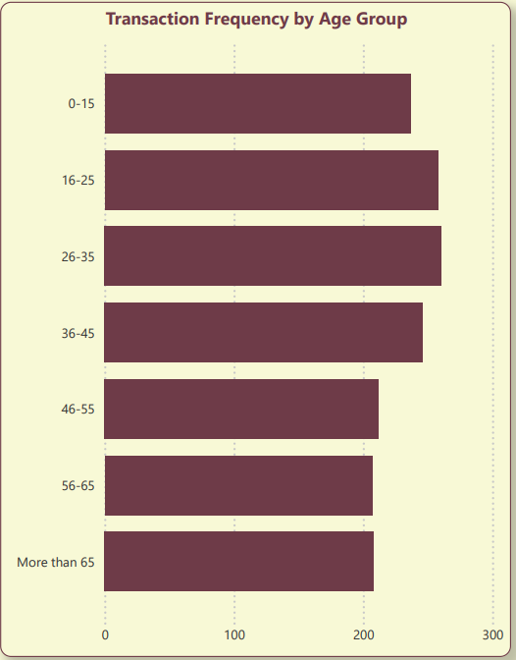
Transaction Frequency by Age Group
Customers between 15-25 years have the highest transaction frequency (260).
Interestingly, customers above 65 years have a higher transaction frequency (216) than the 56 - 65 & 46 - 55 age groups (207 & 205 respectively).

Slide 12
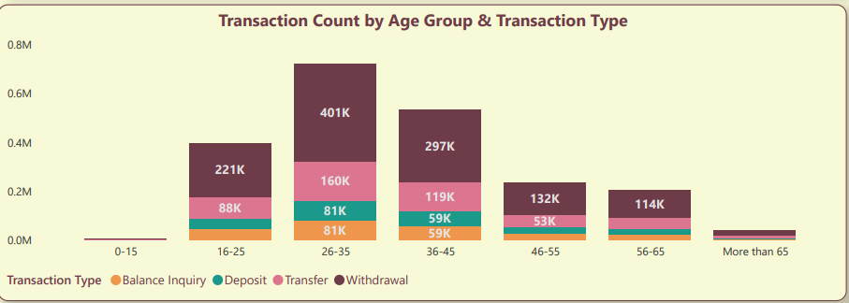
Transaction Count by Age Group & Transaction Type
Across all Age Groups, Withdrawals is the common transaction type, followed by Transfers; Highest being in age group 26-35 followed by 36-45.
Interestingly, Deposits & Transfers account for a significant number of transactions across all Age Groups.

Slide 13
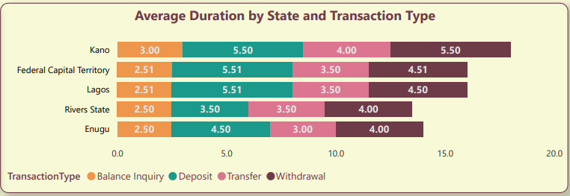
Average Duration by State and Transaction Type
Across all locations, Withdrawals has the longest duration on average.
Kano’s average Withdrawal, Transfer, and Balance Inquiry durations are comparatively higher than other locations.
Rivers & Enugu have lower average transaction duration for Deposits, Transfers, & Withdrawals when compared to other locations

Slide 14

Recommendations for Increasing Customer Retention and Utilization rate

Slide 15
Data-Driven Customer Retention Strategies
Enhance Transaction Efficiency:
Upgrade ATM software and hardware to reduce transaction times, especially in Kano.
Implement user-friendly interfaces and clear instructions to streamline transactions.
Expand Service Offerings and Accessibility:
Introduce additional services like bill payments and mobile top-ups at ATMs.
Extend ATM operating hours in high-utilization areas to accommodate more users.
Customer Education and Support:
Conduct programs to inform users about the full range of ATM services.
Provide dedicated customer support for quick resolution of ATM-related issues.

Slide 16
Increasing Utilization rate
Optimize ATM Distribution and Maintenance:
Place ATMs in high-traffic and underserved areas, particularly in the FCT.
Ensure a robust maintenance schedule to minimize downtime and improve functionality.
Targeted Marketing and Customer Engagement:
Develop campaigns offering incentives like fee waivers and cashback for frequent usage.
Engage customers with personalized communications highlighting diverse ATM transaction benefits

Slide 17

Timeline for Implementation
Phase 1: Immediate Actions (0-3 Months)
1
Upgrade ATM software and hardware to enhance transaction efficiency.
Develop and launch targeted marketing campaigns to boost utilization.
Phase 2: Short-Term Initiatives (3-6 Months)
2
Optimize ATM distribution by placing new machines in high-traffic and underserved areas.
Extend ATM operating hours in locations with high utilization rates.
Phase 3: Mid-Term Developments (6-9 Months)
3
Introduce additional services such as bill payments and mobile top-ups at ATMs.
Conduct customer education programs to increase awareness of ATM services.
Phase 4: Long-Term Enhancements (9-12 Months)
4
Implement a robust maintenance schedule for all ATMs to ensure consistent functionality.
Establish dedicated customer support channels for ATM-related issues to enhance customer satisfaction.

Slide 18

Summary
Comprehensive Analysis
The ATM transaction analysis for 2022 across Lagos, Kano, Rivers State, Enugu, and the FCT Abuja revealed:
Processed $39 billion through 2 million transactions by 8,819 unique individuals. Kano had the highest utilization rate (18.6%), while the FCT had the lowest (8.5%). Kano showed the longest transaction durations across all types, with withdrawals having the highest amounts on average. Customers aged 15-25 had the highest transaction frequency (260), with withdrawals being the most common transaction type across all age groups.
Strategic Recommendations
To enhance customer retention and utilization rates:
Upgrade ATM software/hardware, especially in Kano. Introduce additional services like bill payments and extend ATM operating hours. Strategically place ATMs in high-traffic/underserved areas, particularly the FCT. Ensure a robust maintenance schedule to minimize downtime. Launch targeted marketing campaigns with incentives. Conduct customer education programs and provide dedicated support for ATM issues.
Investment Potential
Implementation Timeline:
0-3 Months: Upgrade ATMs and launch marketing campaigns.
3-6 Months: Optimize ATM placement and extend operating hours.
6-12 Months: Introduce new services, conduct education programs, and enhance maintenance and support.

Slide 19

Thank you
Thank you for your time and attention.
Connect Via:
Email: rupsachaudhuri9@gmail.com
LinkedIn
GitHub

